Slide 1
Reinforcement Learning Practice – From DQN to PPO/GRPO
Jiayi Zheng | 50039453

Slide 2

Outline
Why Reinforcement
What I know about RL (DQN / Double DQN / PPO / GRPO)
My project: Double DQN on Flappy Bird
Current results
Code & future directions

Slide 3
Why Reinforcement

Slide 4
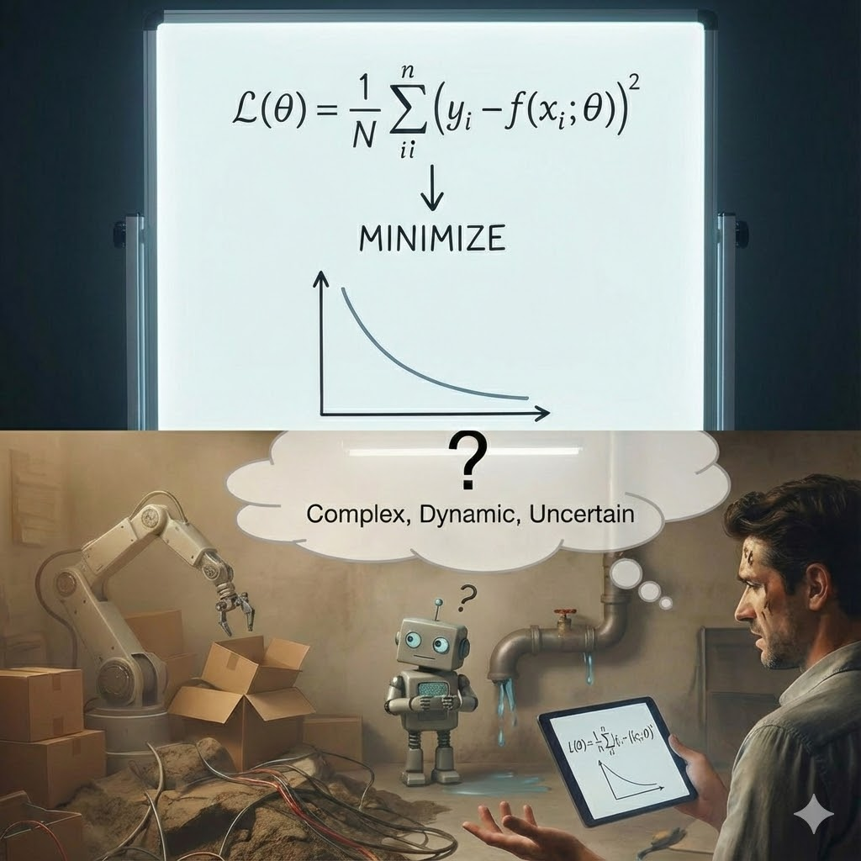
Learning for Real-World Problems
RL does not search for the lowest loss — it searches for the best long-term strategy.
• Real-world tasks lack clear, differentiable loss functions
• Dynamic, uncertain, and multi-step
• Outcomes depend on sequences of actions, not single predictions
• Traditional gradient descent is insufficient
• Assumes a fixed objective
• Seeks a minimum of a static loss function
• Cannot handle delayed or interactive feedback
• Reinforcement Learning is outcome-driven
• Learns a policy (best behavior), not a parameter minimum
• Maximizes long-term cumulative rewards
• Uses exploration to discover better strategies

Slide 5
What I Know About RL

Slide 6
What I Know About RL
Environment, State, Action, Reward, Policy
Goal: maximize long-term cumulative reward
Value-based RL: DQN, Double DQN
Policy-based RL: PPO, GRPO

Slide 7
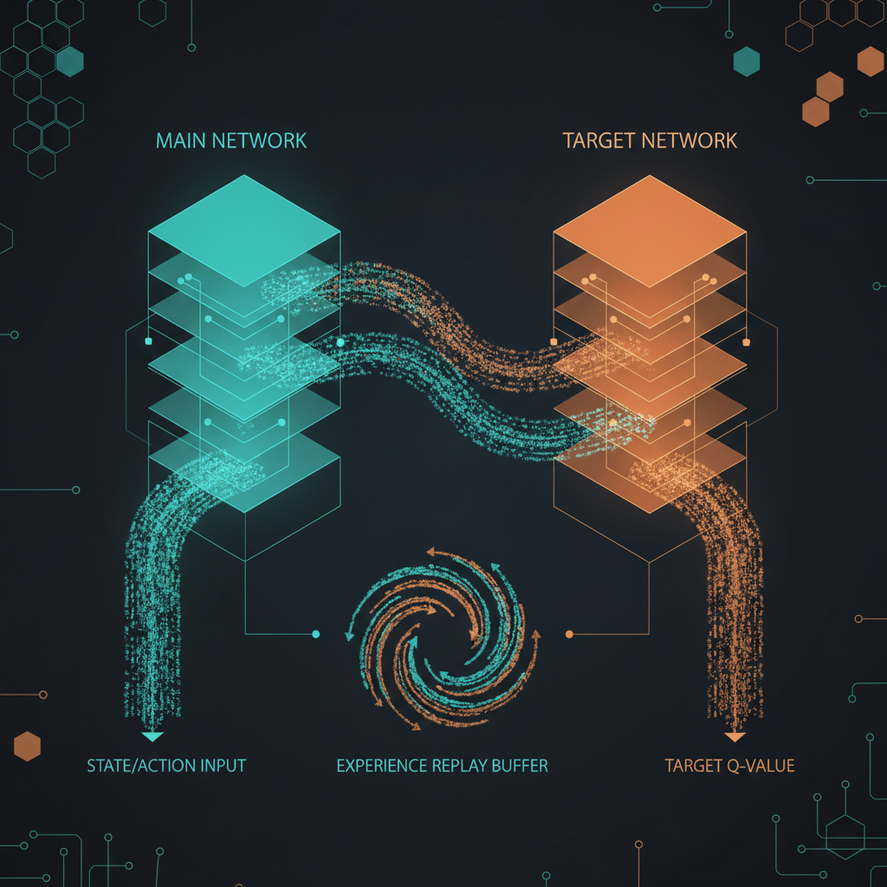
DQN Overview
Main Q-network + Target Q-network
Main network updated every step
Target network updated every N steps

Slide 8
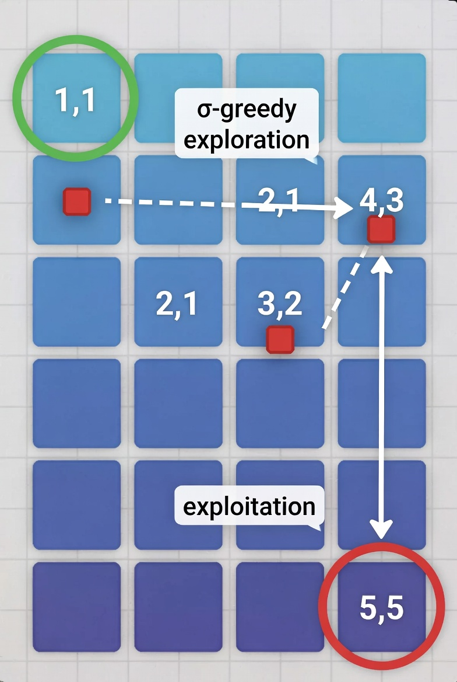
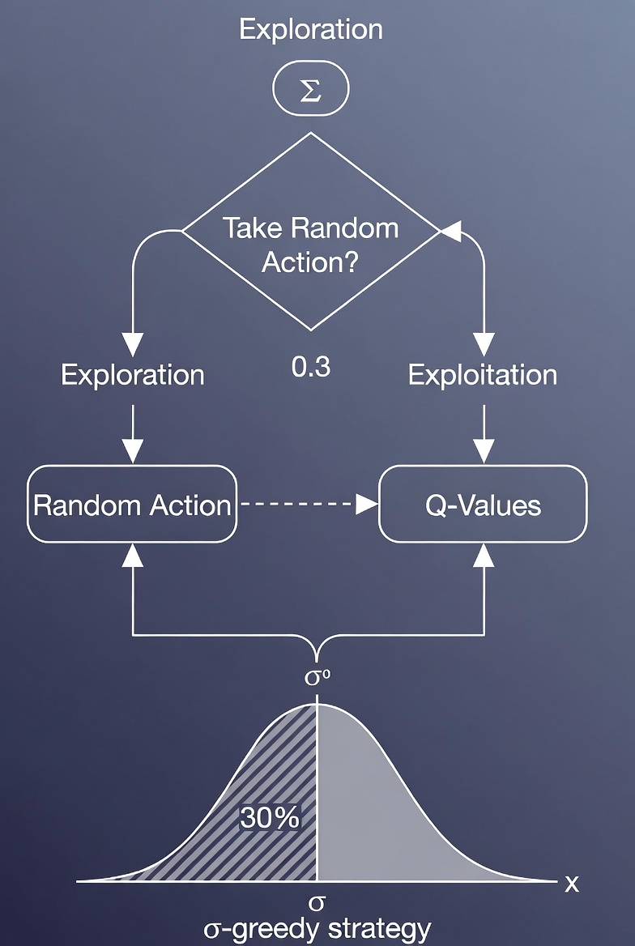
DQN Overview
ε-greedy exploration (ε decays from 0.5 → 0.05)
# take FlappyBird as example
if random.random() <= epsilon:
# Exploration
jump_random_prob = 0.20
if random.random() < jump_random_prob:
action_index = 1 # jump
else:
action_index = 0# not jump
else:
# Exploitation
action_index = int(np.argmax(q_values_np))

Slide 9
Q-value & TD Target
Q = expected discounted future reward
TD target: y = r + γ max Q_target(s’, a’)
Train Q_main(s,a) to match y

Slide 10
Double DQN Improvements
Fixes overestimation in DQN
Main net selects a_max = argmax Q_main
Target net evaluates Q_target(s’, a_max)
More stable and accurate

Slide 11
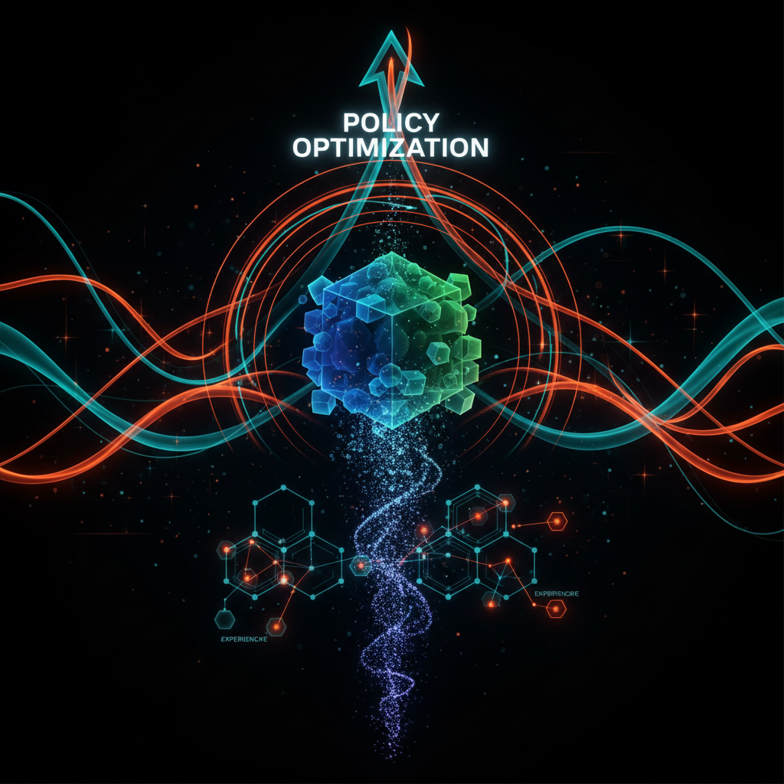
PPO Overview
Policy-gradient algorithm
Learns π(a|s) probability distribution
Supports continuous actions
Clip prevents unstable updates

Slide 12
GRPO
More aggressive version of PPO
Less clipping for positive advantage
Strongly penalizes low-advantage actions
Ideal for LLM RLHF/RLAIF

Slide 13
RL vs Fine-tuning in LLMs
SFT: imitation only
RL: learns reasoning strategy
RL enables discovery of new patterns

Slide 14
LLM as RL Agent
Environment = math problem
Action = each generated token
Trajectory = entire answer
Reward at end (correct/incorrect)

Slide 15
What I Know About RL

Slide 16
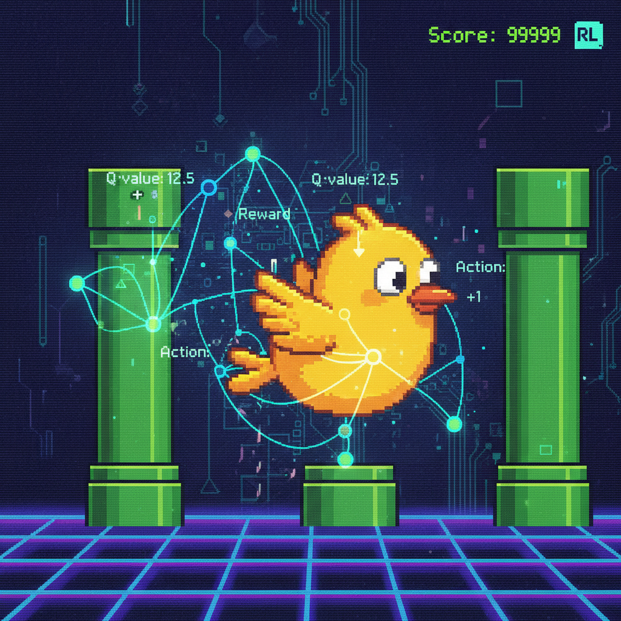
Project: Double DQN Flappy Bird
State = 80×80×4 frames
CNN: Conv1→Conv2→Conv3→FC
Replay buffer 100k
Target net sync every 2000 steps

Slide 17
Results

Slide 18
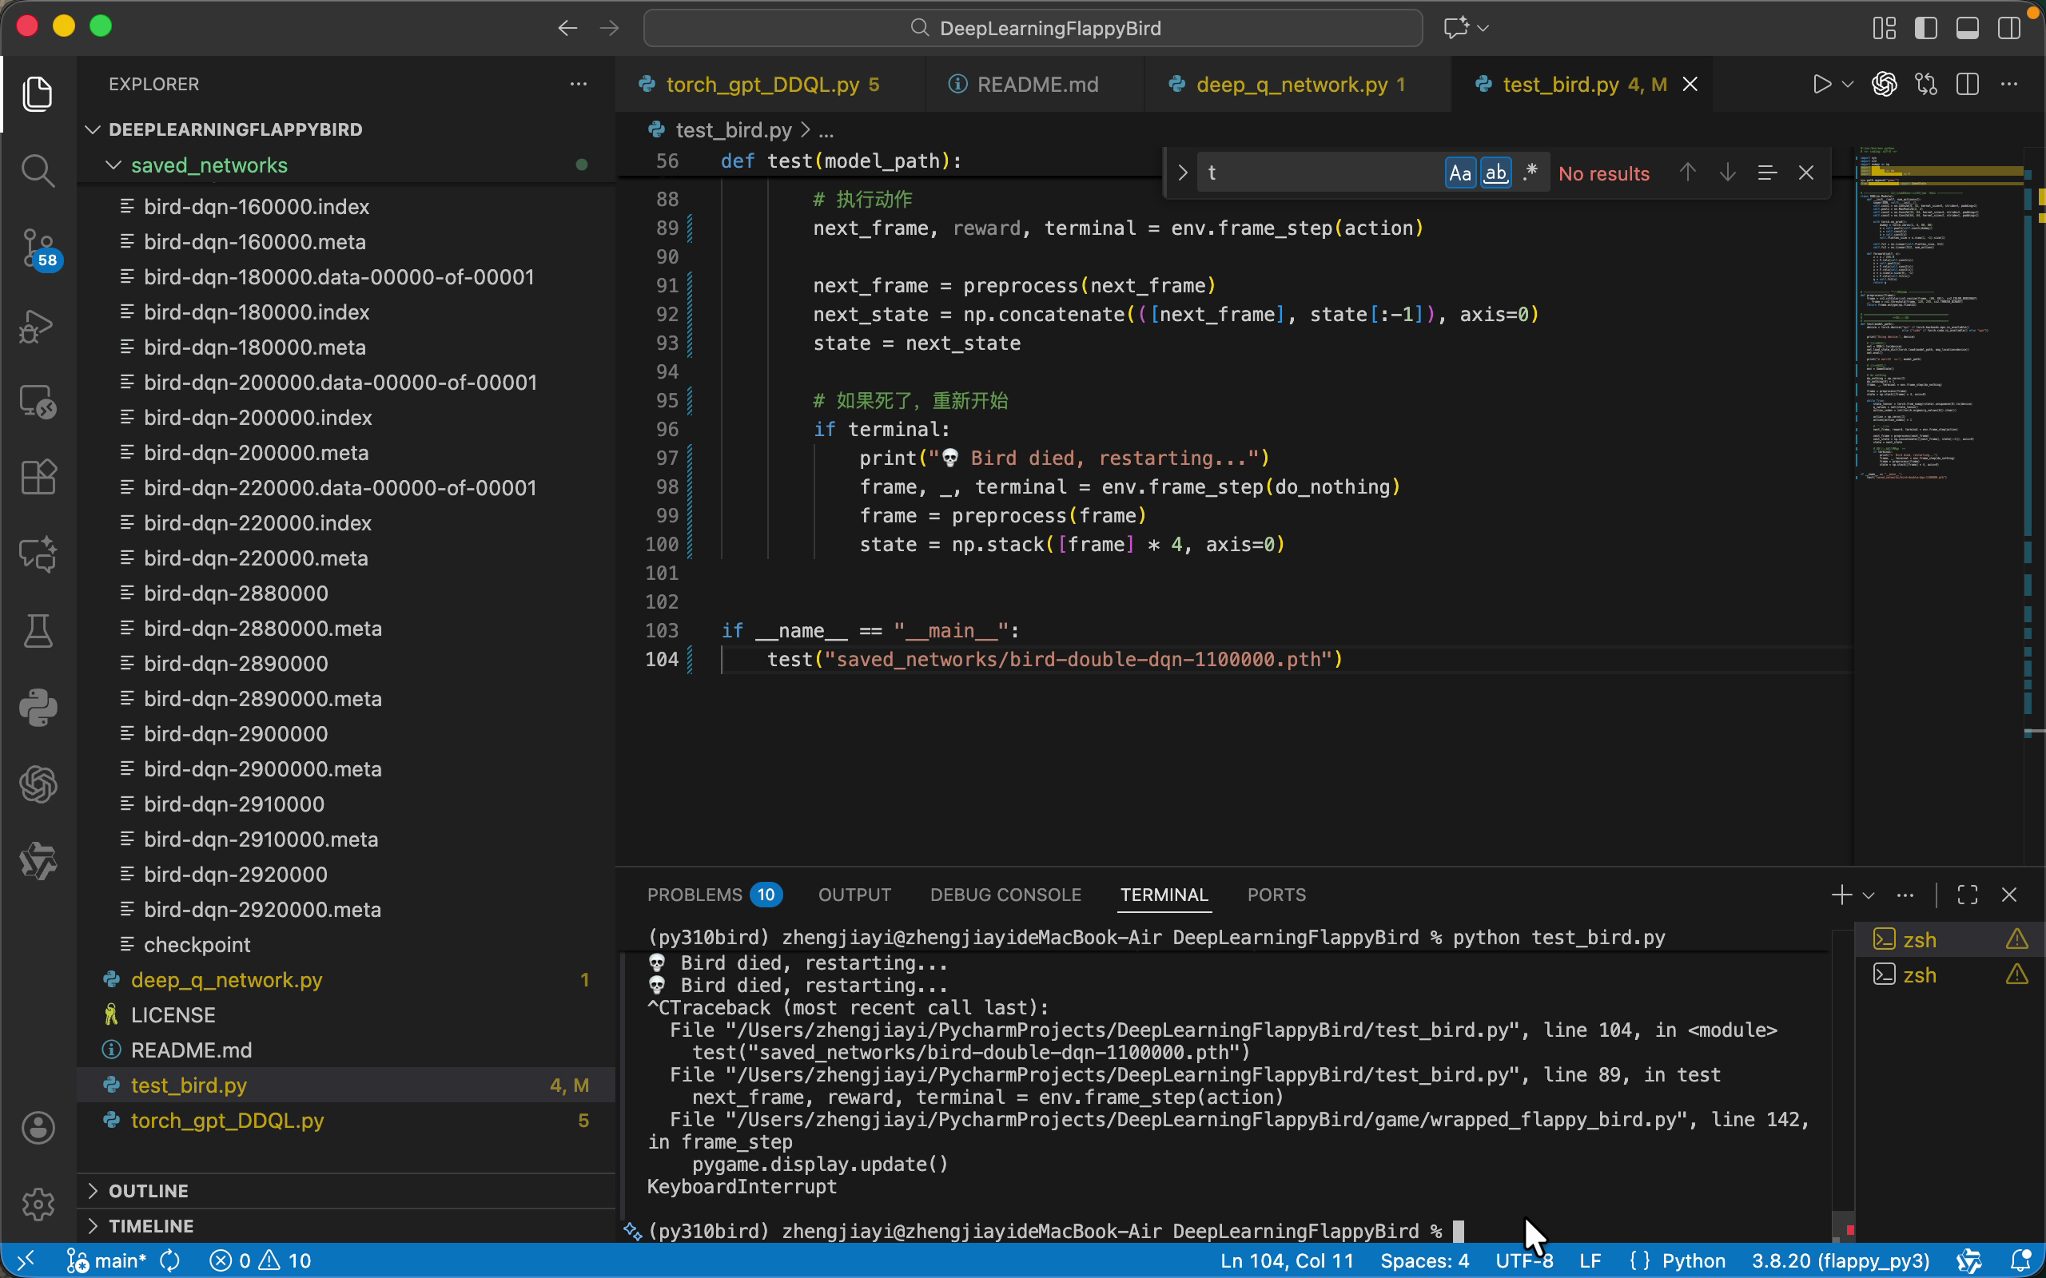
Results

Slide 19
Code & Summary

Slide 20
Code & Summary
Full Double DQN implementation
CNN + Replay Buffer + Double DQN + ε-greedy
Code: https://github.com/zizzey2002/DeepLearningFlappyBird

Slide 21
Final Summary
Understood DQN, Double DQN, PPO, GRPO
Implemented Double DQN project
Future: PPO/GRPO in games & LLM reasoning

